Slide 1
Best neighbourhood for an Indian Restaurant
Capstone Project

Slide 2
Points to consider
Neighbourhood’s that reflect a dining preference for Indian cuisine
Identifying all the “Food” categories for Indian eateries
Household Incomes
Centrally located neighbourhood

Slide 3
Data
Postcodes, latitude and longitude data scrapped from https://www.geonames.org/postalcode-search.html?q=auckland&country=NZ
Household income data was taken from New Zealand's most recent Census (2018). These were downloaded as a.csv file from https://www.stats.govt.nz/
Household income data required additional information, namely latitude and longitude data from https://geocoder.readthedocs.io/index.html

Slide 4
Data Cleaning
From https://www.geonames.org/ 202 neighbourhood's were found for Auckland City and 199 postcodes identified. The data was cleaned and presented in a data frame with 4 features: neighbourhood, postcode, latitude, longitude.
The median household incomes for the greater Auckland region along with associated latitudes and longitudes were provided by https://www.stats.govt.nz/ . Postcodes associated with geolocations were acquired by using the centroid for each postcode's location and reverse geocoding with https://nominatim.org/ . This data was presented in a data frame with 4 features: Income, postcode, latitude, longitude.
The data frame prepared for household incomes was amended to included distances from the city central business district (CBD) to each neighbourhood of interest. This was presented as 2 features. The first as distance as a direct line between 2 points (latitude and longitude), and secondly as the most direct driving route (Google maps).

Slide 5
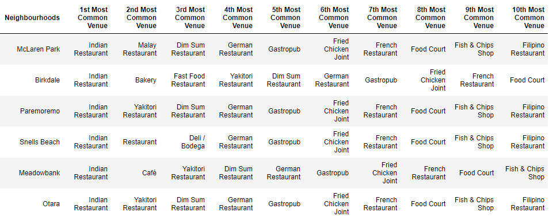
K-means clustering - Cluster 2

Slide 6
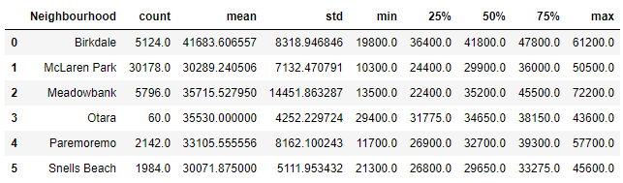
Household Income of Cluster2 Neighbourhood's

Slide 7
Household Income of Cluster2 Neighbourhood's

Slide 8
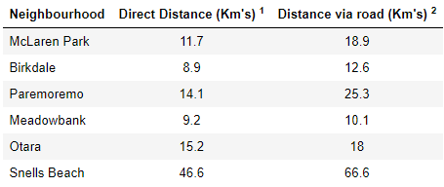
Neighbourhood Sprawl of Cluster 2
1 Distance calculated as a direct line between latitude and longitude points. 2 Distance calculated by most direct driving route, as determined by Googlemaps.com

Slide 9
Conclusions
A cluster of six neighbourhood’s that might potentially meet the needs of the client were found using a K-means algorithm.
An examination of median household incomes showed that Birkdale, Meadowbank and Otara had a higher incomes and Snells Beach at the lower end.
Using the Auckland CBD as a centroid, Birkdale and Meadowbank were the most central neighbourhood's with Snells beach representing the most isolated location.
Further information beyond the scope of this report would assist the client decide on the best location to open her first restaurant. Such as commercial property availability and location, cost of property purchase or lease, purchase or rent of personal living arrangements (house).

